Slide 1

Helping your Child
Prepare for Testing
Mrs. Iran Miranda
Testing Coordinator
December 2016

Slide 2
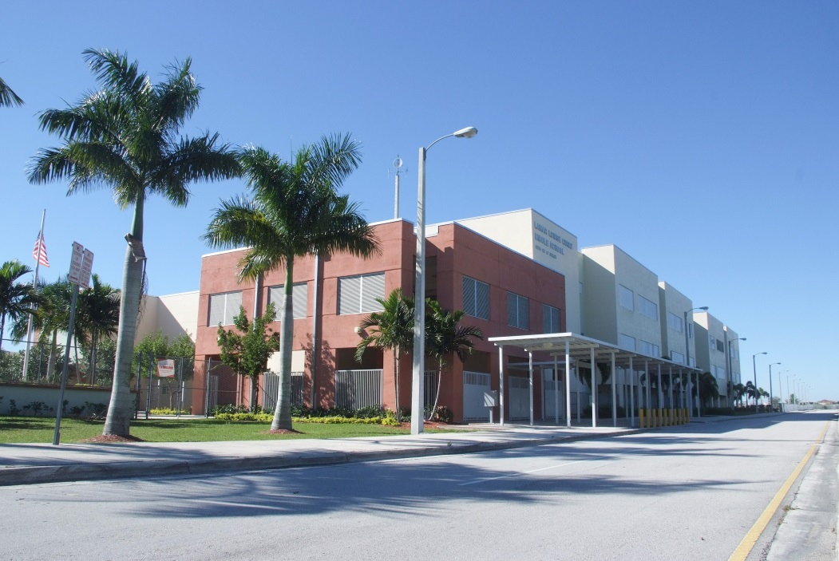


2016 State Assessment
Highlights
Notes:
In June, FLDOE released results from the Spring 2016 administration of FSA, FCAT and the EOC assessments.
The FSA, which is largely administered via computer, was first administered last year, with a myriad of computer-related problems, leading to concerns regarding the validity of the results. As such, the results of this second administration were greatly anticipated.

Slide 3
FSA English Language Arts
Percent Scoring Levels 3-5
 | 2015 | 2016 | Difference
LLCMS | 67 | 70 | +3
Notes:
The FSA English Language Arts assessment is administered in Grades 3 through 10, with a writing component added in Grades 4 and up.
In Spring 2016, students in Grades 5-10 took the Reading portion on computer, and those in grades 8 -10 took the writing part on the computer as well.
MDCPS was comparable to the state on the FSA ELA. The most improvement was seen in Grade 6 with a 2 percentage point increase.

Slide 4
FSA Mathematics
Percent Scoring Levels 3-5
 | 2015 | 2016 | Difference
LLCMS | 51 % | 58% | + 7
Notes:
FSA Mathematics was administered via computer in grades 4 – 8, with only Grade 3 students taking math on paper
M-DCPS students outpaced the state in 2016 in mathematics. (measures of status and growth)
Higher percentages of M-DCPS elementary students scored in Levels 3 or above in math than their counterparts statewide (Grades 3, 4, and 5).
In grade 3, there was a 5 percentage point gain from 2015 to 2016 in the M-DCPS, compared a 3 point gain statewide.
In grade 5 there was a 4 percentage point increase in M-DCPS, compared to no gain statewide.
In the middle grades, M-DCPS met or exceeded gains shown statewide, with a 3 percentage point increase in grade 8.

Slide 5
2015 and 2016 Algebra 1 EOC
Percent Scoring Levels 3-5
Algebra 1 | 2015 | 2016 | Diff 2015-2016
Grade 7 | 85 | 92 | +7
Grade 8 | 77 | 83 | +6
Grade 9 | 33 | 32 | -1
Grade 10 | 17 | 35 | +18
Grade 11 | 21 | 41 | +20
Grade 12 | 3 | 37 | +34
Total M-DCPS | 52 | 52 | 0
Total State | 56 | 55 | -1
LLCMS | 72 | 86 | +14
Notes:
All EOCs are administered via computer. (except for students who qualify for paper-based accommodations) EOC results represent all students who were enrolled in the appropriate course, and are not grade-specific.
The majority of the students taking Algebra 1 were in Grade 9 (15,453 9th graders; 6,494 8th graders)
On the FSA Algebra 1 assessment, M-DCPS overall performance remained stable while statewide there was a one percentage point decrease.
Middle school students enrolled in Algebra 1 increased overall by 6 percentage points, with 86% scoring at or above Level 3.
(In grades 10 – 12 incredible growth was seen, but it represented fewer than 500 students who were taking the test for the first time.)
High School Mathematics EOC Strategic Academic Plan:
1. Implement new standards aligned instructional materials in AGA (Algebra 1, Geometry, Algebra 2) inclusive of the 5E instructional resources and the Personal Math Trainer (PMT), to facilitate personalized learning.
2. Provide monthly regional frontload content clinics for Algebra I, Geometry, and Algebra 2 teachers.
3. Institute Algebra 1A and 1B courses for schools on a 4X4 schedule, in addition recommend all schools to minimally schedule either intensive math in addition to the core or the Algebra 1A or 1B combo for ALL Level 1 students.
4. Target schools with 40% or less proficiency rates on the Algebra I, Geometry, and Algebra 2 EOC’s and provide them with job-embedded support and PLC/planning facilitation.

Slide 6

2015 and 2016 Geometry EOC
Percent Scoring Levels 3-5
Geometry | 2015 | 2016 | Difference 15-16
District | 48 | 46 | -2
State | 53 | 51 | -2
Notes:
The majority of the students taking Geometry were in Grade 10 (14,965 10th graders; 7,301 9th graders)
Over all the District’s performance mirrored that of the state, with a slight decrease in the percent scoring in Levels 3 or above.
High School Mathematics EOC Strategic Academic Plan:
1. Full Implementation of standards aligned instructional materials in AGA (Algebra 1, Geometry, Algebra 2) inclusive of the 5E instructional resources and the Personal Math Trainer (PMT), which facilitates personalized learning.
2. Monthly regional frontload content clinics for Algebra I, Geometry, and Algebra 2 teachers.
3. Target schools with 40% or less proficiency rates on the Algebra I, Geometry, and Algebra 2 EOC’s and provide them with job-embedded support and PLC/planning facilitation.

Slide 7
2015 and 2016 FCAT 2.0 Science
Grade 8
Percent Scoring Levels 3-5
Grade 8 | 2015 | 2016 | Difference 15-16
District | 41 | 42 | +1
State | 48 | 48 | 0
LLCMS | 56 | 53 | -3
Notes:
FCAT 2.0 Science is the one component of the program that remains a paper-based administration.
District students continued to improve on the Science assessment, while statewide scores declined or remained stable.

Slide 8
2015 and 2016
Biology EOC
Percent Scoring Levels 3-5
Biology | 2015 | 2016 | Difference 15-16
District | 63 | 61 | -2
State | 65 | 64 | -1
100% Passed @ LLCMS
Notes:
The Science and Social Studies EOCs are still aligned to the NGSSS. They are computer-based assessments.
There was a slight decline across the state, and in the M-DCPS.
Biology EOC Strategic Academic Plan:
Re-evaluate and revise instructional resources for Biology and include additional thematic labs that provide high student engagement, critical thinking STEM activities, and hands-on investigations/applications.
Streamline student BYOD resources to support flipped classroom learning experiences and provide Biology teachers with the necessary training to implement this strategy effectively.
Target schools with 40% or less proficiency rates on the Biology EOC and provide them with job-embedded support and PLC/planning facilitation.
Provide monthly content aligned professional development in both face-to-face and virtual modalities to facilitate PLC’s and address classroom environment, instructional practices, new instructional resources, and depth of content knowledge.

Slide 9
2015 and 2016
Civics and US History EOC
Percent Scoring Levels 3-5
Civics | 2015 | 2016 | Difference 15-16
District | 61 | 64 | +3
State | 65 | 67 | +2
LLCMS | 72 | 74 | +3
Notes:
M-DCPS students improved on both Social Studies EOCs.
Civics is a middle-grades course, and most students take it while in grade 7 (n=25,925)
Outpaced the state, with a 3 percentage point increase in Civics.
US History is typically taken in Grade 11 (n= 22,196). M-DCPS showed a 1 percentage point increase in U.S. History.

Slide 10

The Bottom Line
Despite the fact that new Florida Standards are more rigorous, M-DCPS demonstrated increases in student achievement, oftentimes surpassing that of the State.
Data shows that LLCMS usually surpasses District and State passing percentages.
☺

Slide 11

Important Dates
M-DCPS 2016-2017 Testing Calendar
  Frequent Updates/Modifications
  Your copy is marked w/ upcoming exams
ConnectEds/Letters/Social Media Posts
  We will notify you when testing windows open/close

Slide 12


When Are they Testing?
Writing (English Language Arts) --- February 27-March 3
  Paper-Based: Grades 6 and 7
  Computer-Based: Grade8
English Language Arts (ELA) and Mathematics ---April 17– May 12
  Paper-Based Accommodations and Computer Based Testing for Grades 6-8
FCAT 2.0 Science Test for 8th Graders (Paper Based Testing)---May 1-5
Computer-Based End of Course Assessments (EOC) ---April 17–May 19
  Algebra 1, Geometry, Biology, Civics

Slide 13
Useful Websites
www.fsassessments.org
www.dadeschools.net

Slide 14
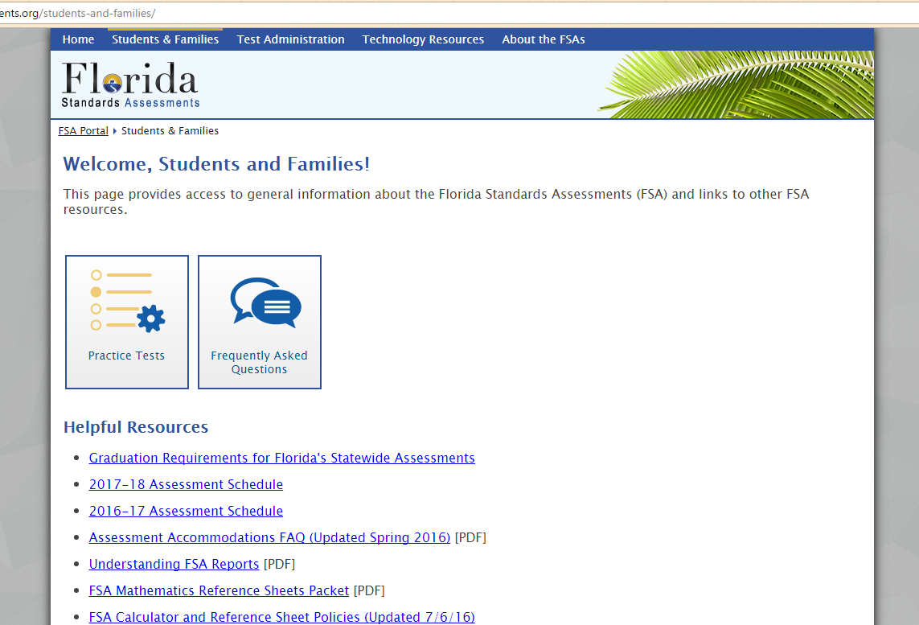

Slide 15
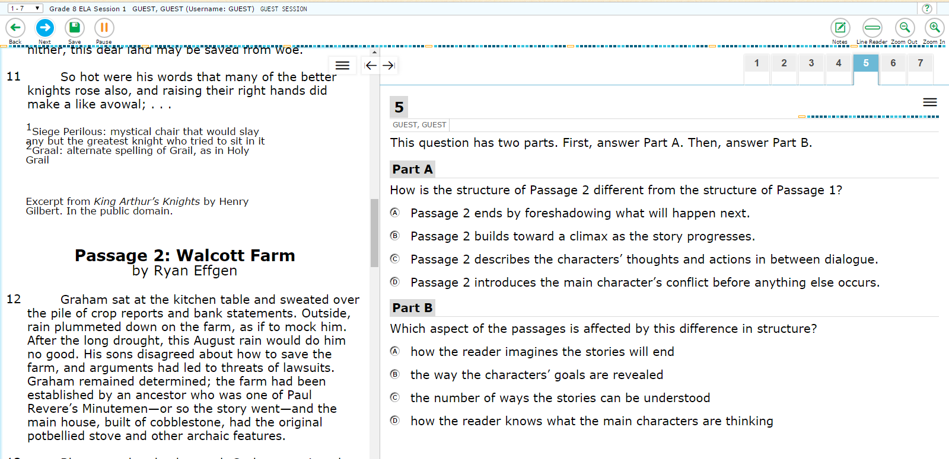
Sample Questions

Slide 16
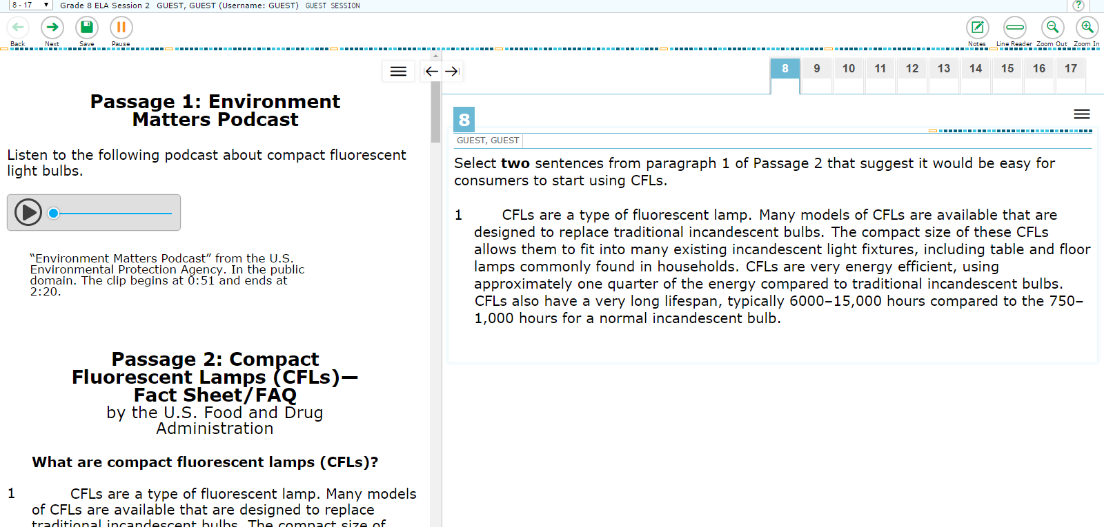

Slide 17
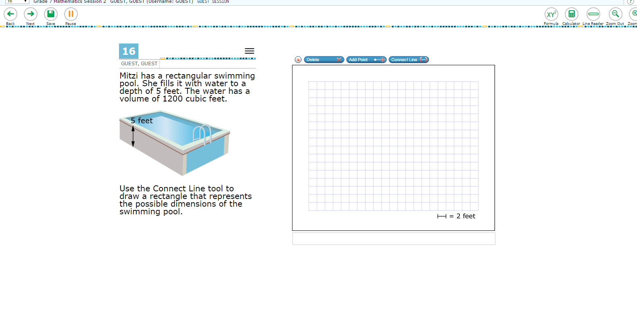

Slide 18
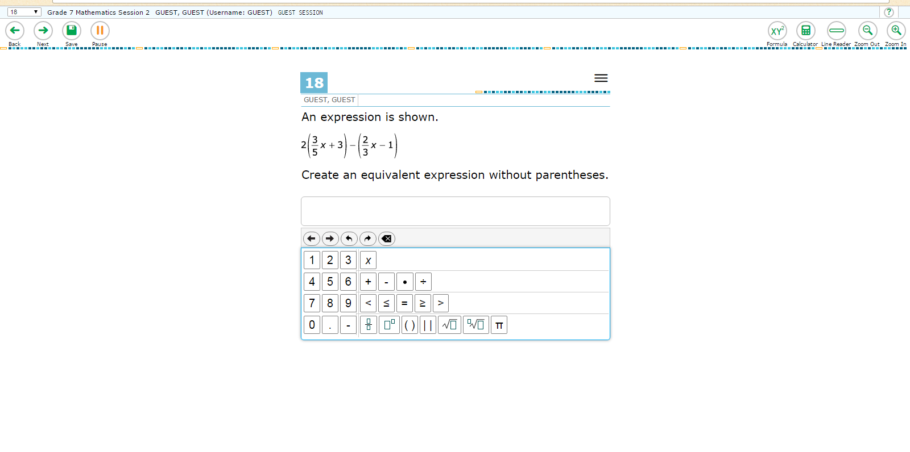

Slide 19
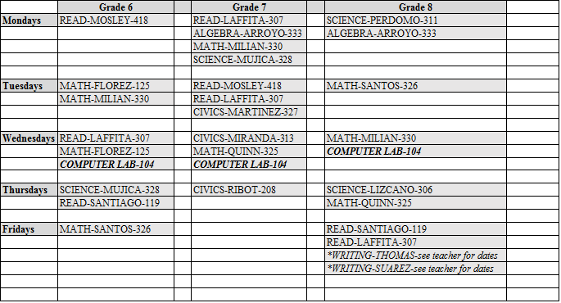
Tutoring

Slide 20

Online Resource purchased by M-DCPS
Provides Diagnostic information
3 testing windows
Teachers can also assign as remediation or reinforcement

Slide 21

Data Chats
Teachers are conducting Data Chats with students in order to help them understand their performance (strengths/weaknesses) in the various classes.
These documents will be shared
with you.

Slide 22
How can you help?
Monitor Grades, Projects, and HW
Bring your child to tutoring (if need be)!!!
Make sure they do not miss classes during testing dates!
Encourage them to use online resources
Be their “cheerleader!”

Slide 23



