Slide 1

2023-2024
STE(A)M Overview

Slide 2
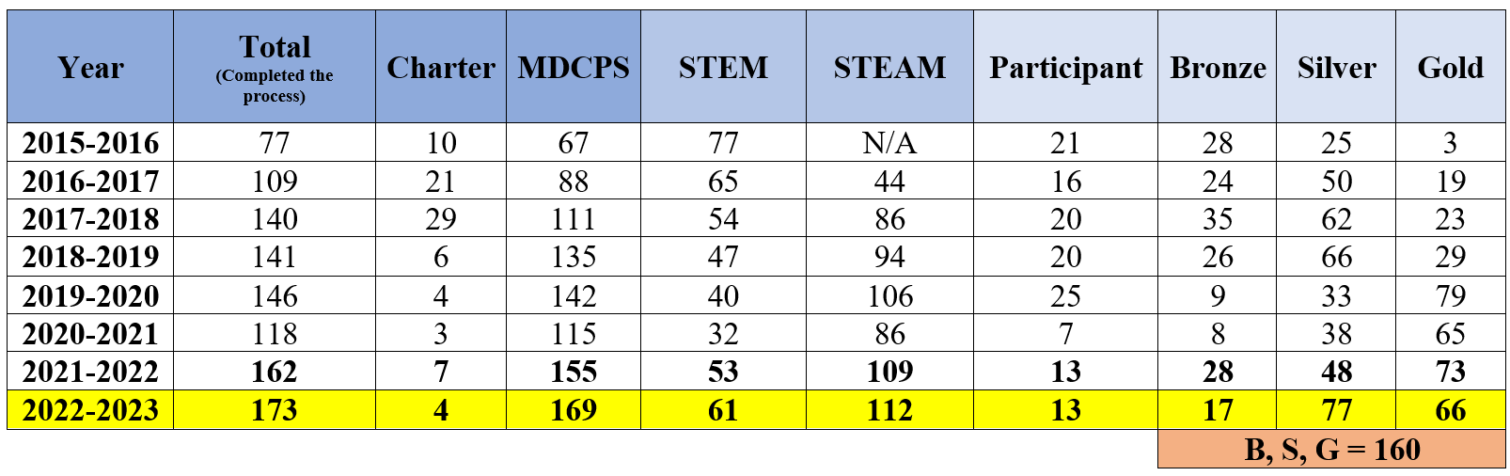
STEAM Data

Slide 3
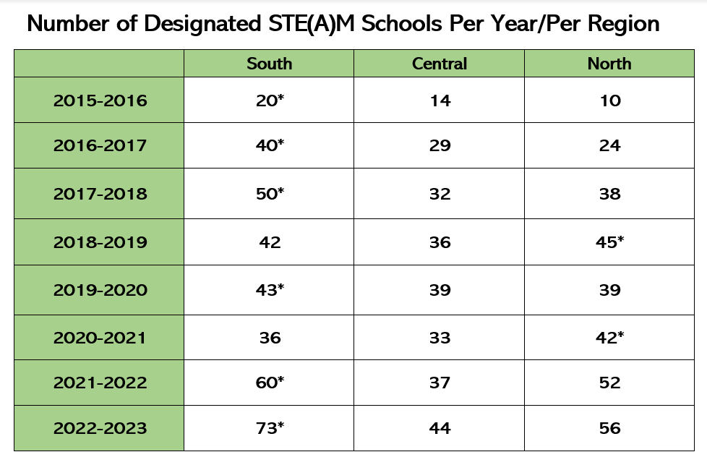

Slide 4





STE(A)M is the intentional integration of
Science
Technology
Engineering
Arts
Mathematics

Slide 5
STE(A)M School Designation
Program Timeline
July
The yearly STE(A)M School Designation program opens for registration via the link provided on a weekly briefing.
October 31st
(2nd Quarter)
The STE(A)M School Designation visits begin.
June
The STE(A)M School Designation program closes, and the adjudication process begins.

Slide 6
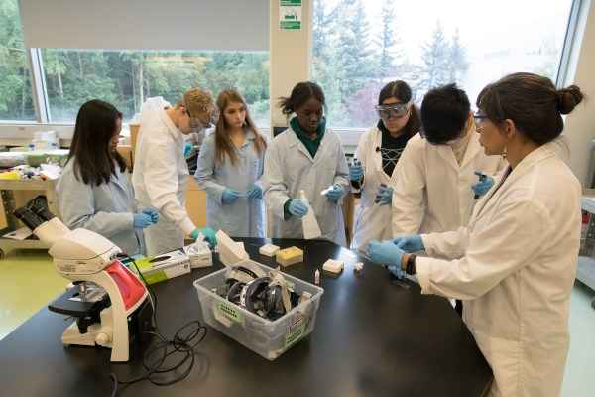
Who integrates STE(A)M?
Primary
Grades PreK - 5th (ES & K8)
Classroom required to integrate STE(A)M are:
  Science classrooms
  Mathematics classrooms
  Art classroom (if STEAM)
  Music classroom
  ESE and SPED teachers that teach one or more of the STE(A)M disciplines
Secondary
Grades 6-8 (MS, K-8, HS)
Classroom required to integrate STE(A)M are:
  Science classrooms
  Mathematics classrooms
  Visual Art classrooms (if STEAM)
  Performing Arts classrooms (if STEAM)
  Career and Technical Education classrooms
  ESE and SPED teachers that teach one or more of the STE(A)M disciplines

Slide 7
All About The Visit
Visitation date requests are made during the initial application process by the school’s administration.
All applicant schools will receive a visit from the STEAM School Designation team.
  Virtual
  Face-To-Face
The master schedule provided is the determining factor of who is a STEM/STEAM teacher.
ALL STEM/STEAM teachers who receive a visit (virtual or face-to-face) are selected at random.
STEM/STEAM should be evident in the classrooms visited (corner/binder/wall).

Slide 8
FACE-TO-FACE
(3 hours @ School site)
Visitation Team is divided into STE(A)M disciplines
Classrooms representing those disciplines are visited
STE(A)M lessons and artifacts are reviewed in collaboration with the school representative
Scores earned for each lesson are discussed with the school representative
Score per discipline will be calculated and shared during the debriefing
Areas of strength and growth will be discussed
A report is sent to the principal 3-5 business days after the visit with the overall integration score.
VIRTUAL
(1 hour on Zoom)
Visitation team is divided into STE(A)M disciplines
Lessons representing those disciplines are uploaded to the Certifying STE(A)M site
STE(A)M lessons and artifacts are reviewed in collaboration with the school representative
Scores earned for each lesson are discussed with the school representative
Score per discipline will be calculated and shared during the debriefing
Areas of strength and growth will be discussed
A report is sent to the principal 3-5 business days after the visit with the overall Integration score.

Slide 9
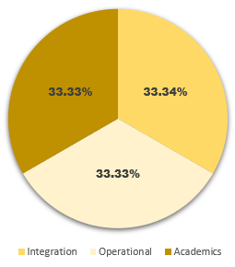
The 3 buckets in
STE(A)M School Designation
Integration – 33.34%
Operational – 33.33%
Academics – 33.33%

Slide 10

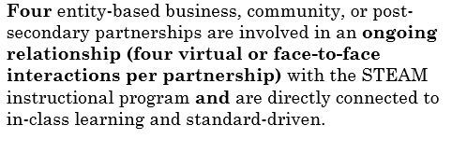
Partnerships

Slide 11
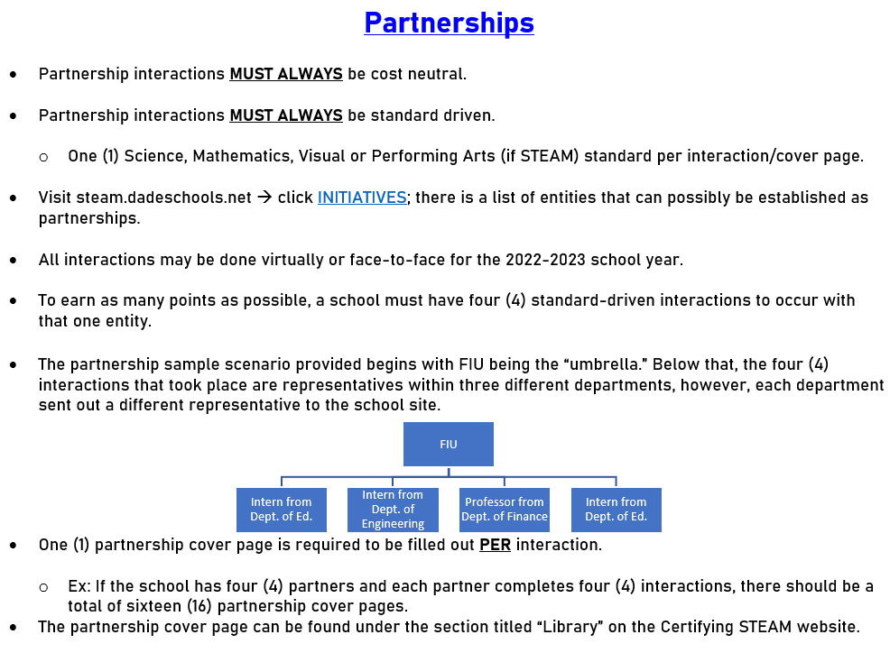

Slide 12
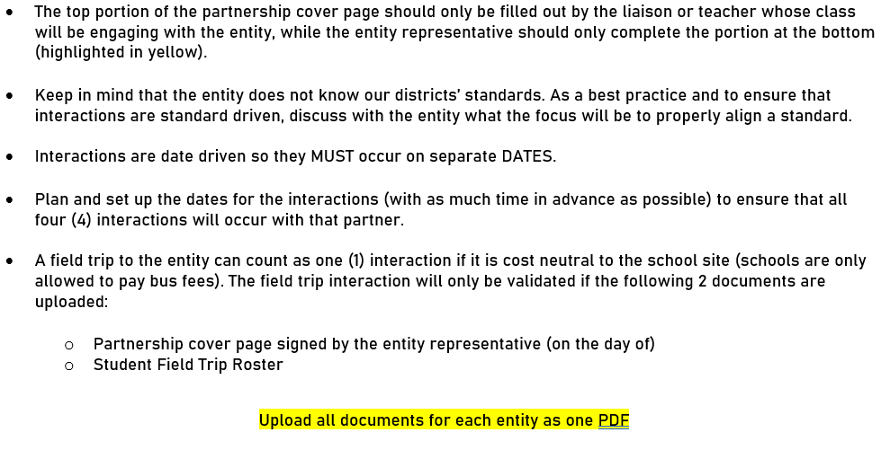

Slide 13
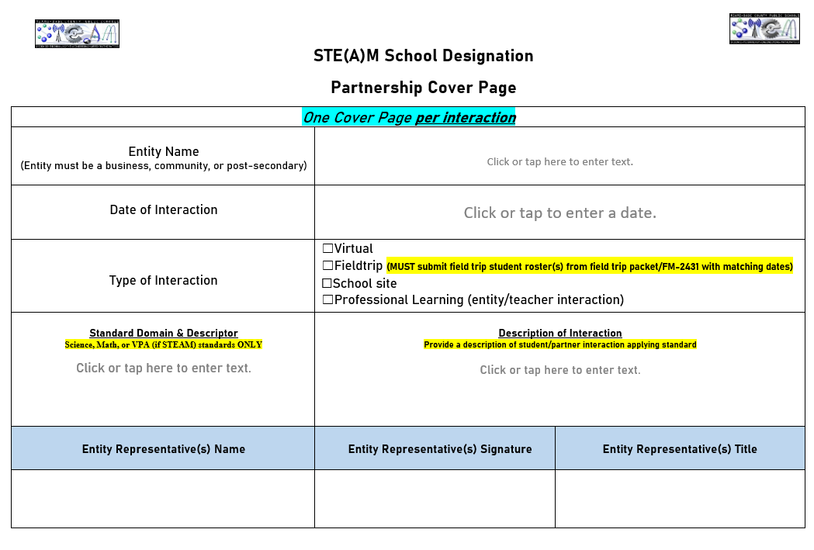

Slide 14
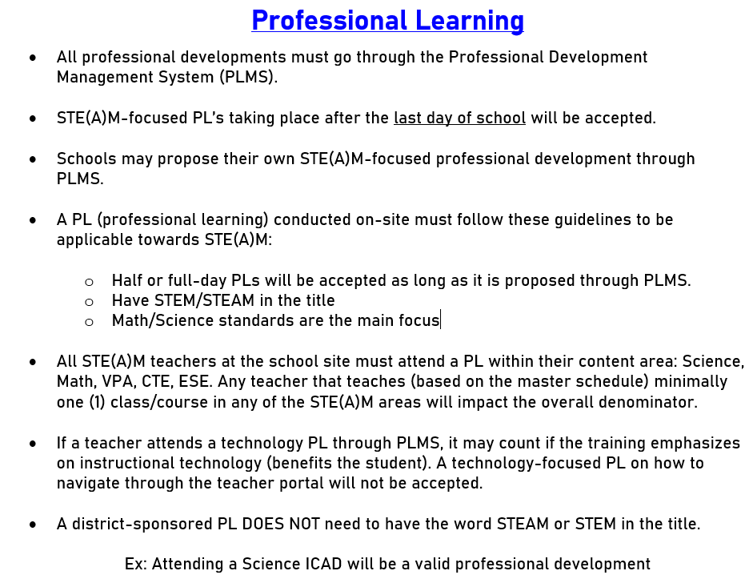

Slide 15
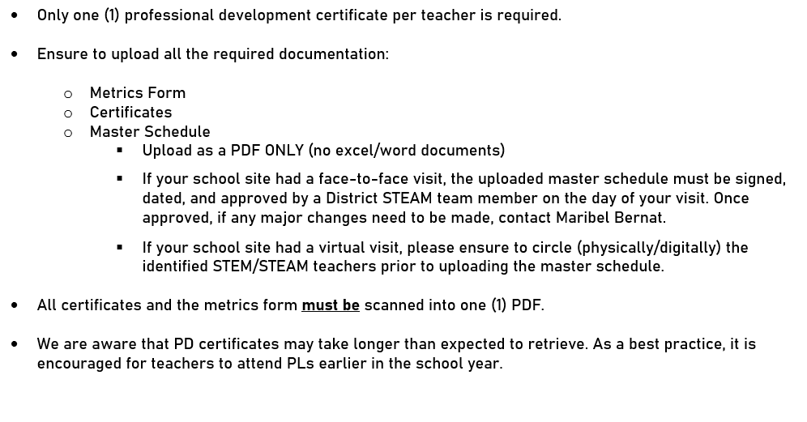

Slide 16
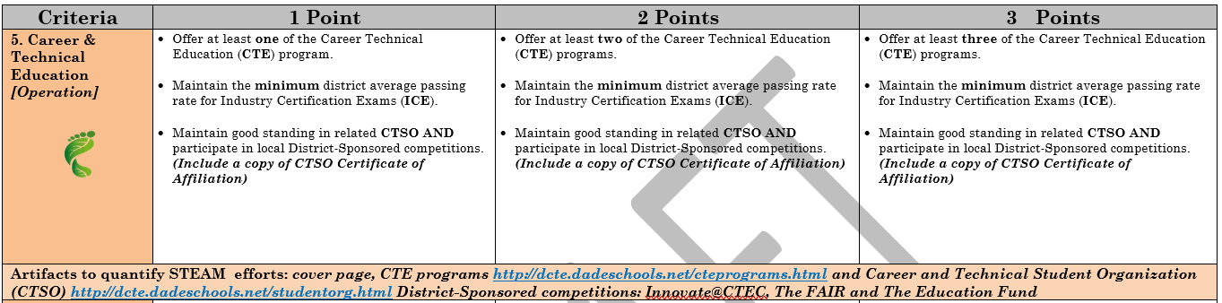
Career and Technical Education (CTE)
(Middle and High Schools Only)

Slide 17
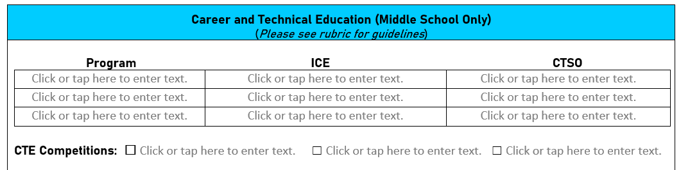
Career and Technical Education

Slide 18
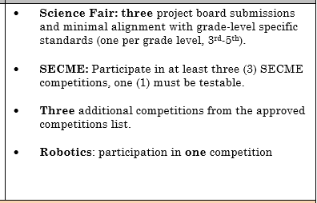
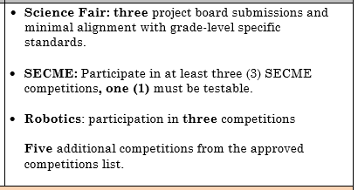
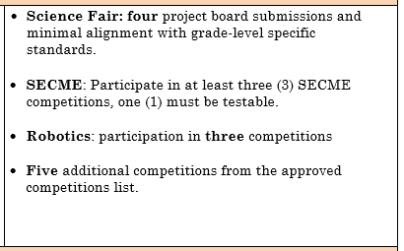
Competitions
3 Points | 3 Points | 3 Points
Elementary
Middle
High

Slide 19
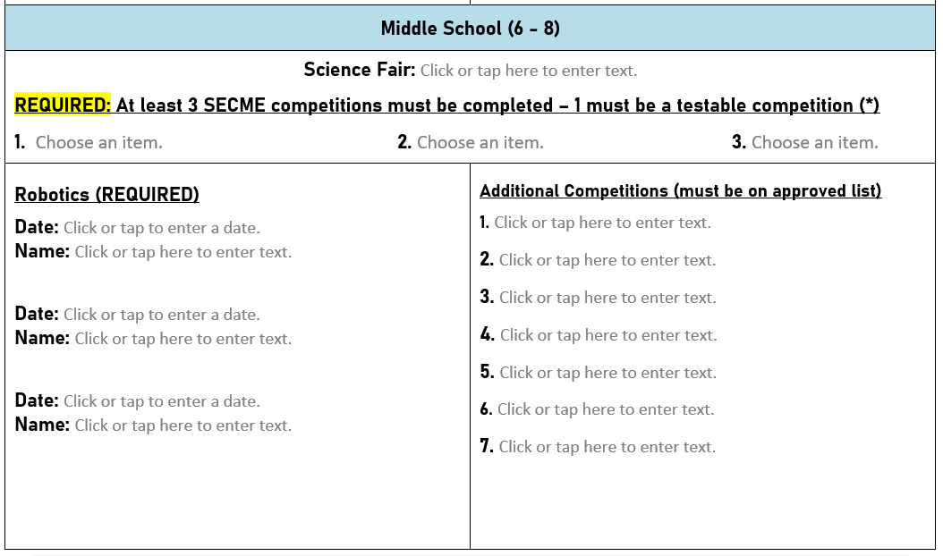

Slide 20
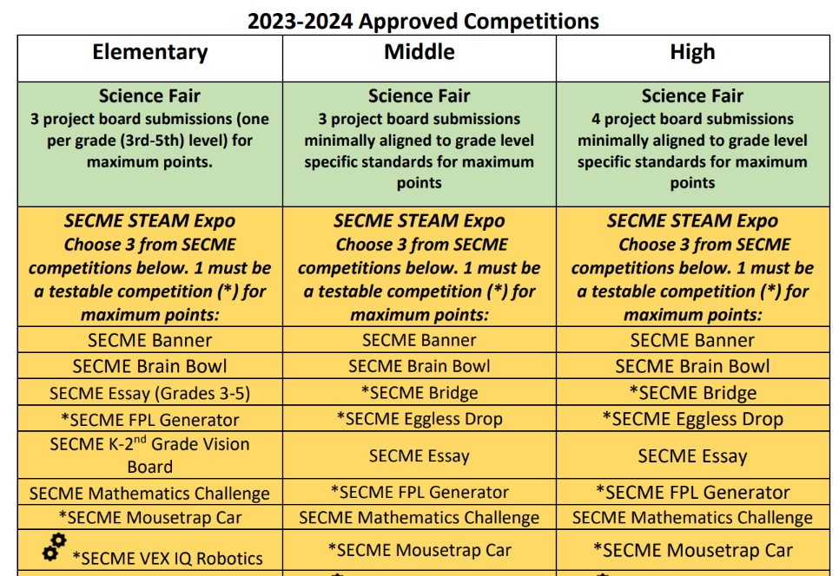

Slide 21
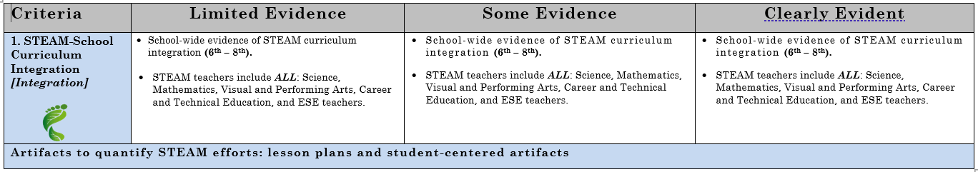
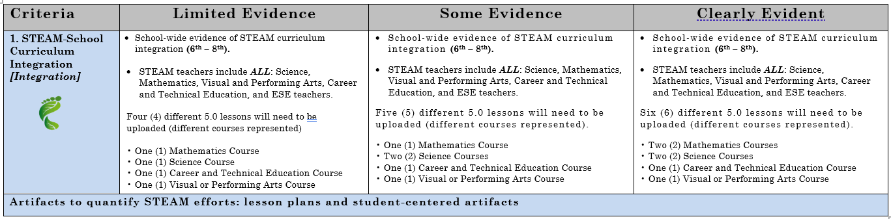
Integration
Face-to-Face
Virtual

Slide 22
How to
integrate
S-T-E-A-M
into a
lesson

Slide 23



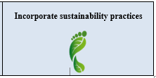
Sustainability
When possible and properly aligns, incorporate in STE(A)M lessons
Partake in sustainability-related competitions

Slide 24
Science
Specific standard-driven lessons as per each grade level
Recommended to stay within the current quarter
Lessons must be developed from the Science standard first if you are a science teacher
Collaborate with grade level/content area teachers to assist with the integration of the other disciplines (Math/Visual or Performing Arts teacher)
Avoid Nature of Science standards as you will only earn ½ a point in Elementary
Fair-game standards are acceptable

Slide 25
Mathematics
Specific standard-driven instruction as per each grade level
Recommended to stay within the current quarter
Lessons must be developed from the mathematics standard first if you are a math teacher
Collaborate with grade level/content area teachers to assist with the integration of the other disciplines (Science/Visual or Performing Arts teacher)
Avoid using K-12 Mathematical practices and obsolete math standards (must be using BEST standards)

Slide 26
Technology
SAMR Model
Transformation
(Grades 2-12)
Modification
significant task redesign.
Redefinition
creation of new tasks and supplements learning.
Enhancement
(Grades PreK -1)
Substitution
supplanting a piece of paper with a computer.
Augmentation
some functional improvement.
No standards are REQUIRED!
Keep in mind to provide students with specific features that they must utilize when working with these programs. That will define which SAMR component the student is focusing on.
Parameters MUST be provided by the teacher to the students of the utilization of technology.

Slide 27
Some Examples of Technology Platforms
Secondary
Grades 6-12
MS Word
MS PowerPoint
MS Excel (not just input of numbers)
Animaker
Book Creator
BandLab (Performing Arts)
Autodesk Tinkercad
Flip
Elementary
PreK – 1st
Discovery Education
Paint 3D
Kahoot
MS PowerPoint
Promethean Board – Needs to be interacting with the board
Grades 2-5
MS Word
Flip
MS PowerPoint
MS Excel (not just input of numbers)
Animaker
Book Creator
Padlet
Quaver

Slide 28
Engineering
NO STANDARDS REQUIRED
Process Infusion (not in isolation):
Real World / Measurable Problem
Planning
Testing
Redesign/
Improve
Communicate Findings
Students should have the autonomy to engineer a prototype based around the STE(A)M standard-driven lesson that is being taught while trying to find the solution to a real-world problem.
Prototyping

Slide 29

Engineering Scale
0 - 2 = 0 pts
3 – 5 = ½ pt
6 = 1 pt
Engineering
When developing your STEAM/STEM lesson keep in mind how the engineering discipline will play its role. There are some science and mathematics standards that are more complex than others to develop a prototype for
Keep in mind that students should be designing a prototype to solve the problem → No models
Ensure that the students first design the blueprint of their prototype
Prototype may be displayed through technology (ex: simulation design - Minecraft)
Must have a measurable problem/goal (Teacher provides the problem/goal to the class)
May be conducted in small groups. Whole group prototypes will not be accepted
Ensure that students are given the opportunity to go through the ENTIRE engineering design process
In order to earn a full point in the engineering discipline, each component must be completed and have accompanying evidence

Slide 30
VPA
(Visual & Performing Arts)
Visit the “Schoology” app in your teacher portal. There you will find the VPA standards per grade level. One of these standards will align with your STEAM lesson.
Collaborating with the visual and or performing arts teacher is always great, as they can assist you in integrating the “A” in your STEAM 5.0 lesson.
STE(A)M Lesson Planning Tips for VPA teachers:
Stay within the current quarter
Lessons must be developed from either the Visual Art OR Performing Art discipline FIRST
Collaborate with Math/Science teachers
Only one lesson per quarter/choose one grade-level
CPALMS

Slide 31
5.0 Guided Lesson
Matrix

Slide 32
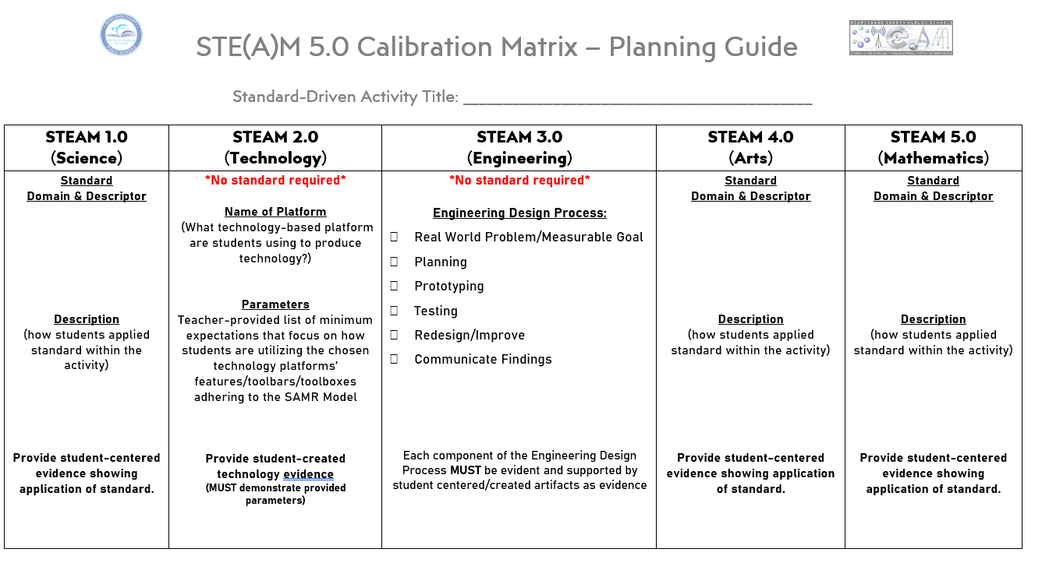

Slide 33
STE(A)M
Lesson Sample

Slide 34
