Slide 1


ALL ABOUT CURRY
2024 INFO

Slide 2




WHAT
WILL WE DISCUSS
Get ready to learn all about:
  IB Magnet Program
  Culinary Arts Program
  IT (Technology) Program
  Course Offerings
  Extra-Curricular Activities
  Tutoring and After Care
  School Accolades and More

Slide 3

APPLY NOW
LINKS CAN ALSO
BE FOUND ON...
YOURCHOICEMIAMI.ORG
OUR WEBSITES
The Magnet Application for the 2025-26 school year opened on October 1st 2024, and will close on
January 15, 2025.
LAMARLOUISECURRY.NET
CURRYIB.COM
YOURCHOICEMIAMI.ORG
APPLY NOW

Slide 4
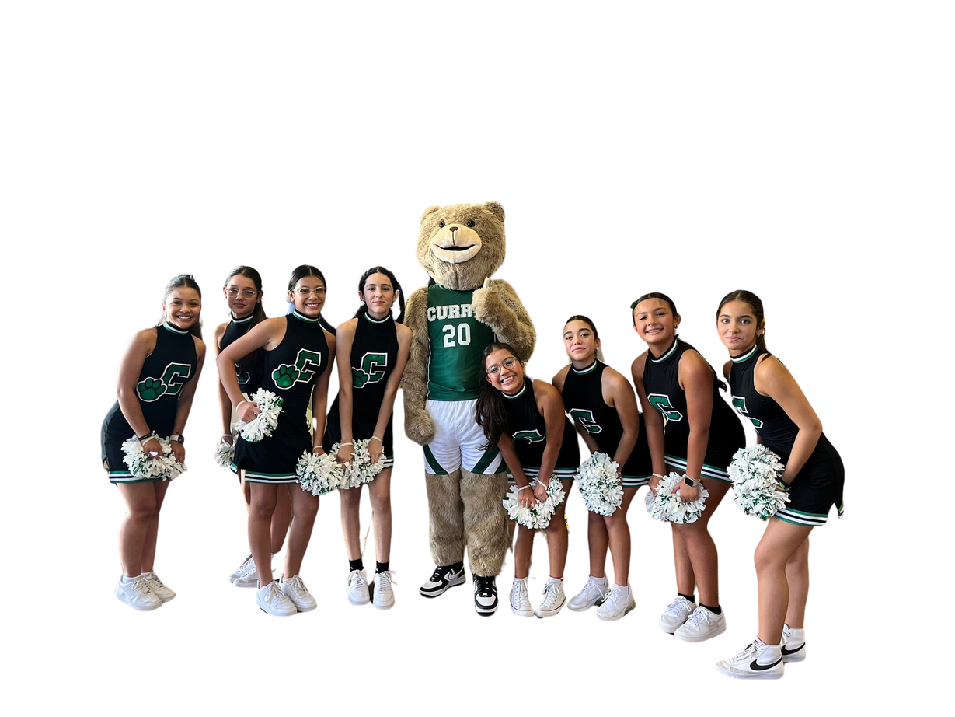
CHECK THIS OUT!
FAST FACTS
  Curry just turned 20!
  We are a Certified Magnet School of America- Demonstration Level
  We are a S.T.E.A.M. Gold Level School
  We were a TOP Magnet School of Excellence (MSA)
  Our courses are offered at ALL levels -Adv, Gifted, ESE, ELL, Regular
  We work with AMAZING partners!

Slide 5

CURRICULUM
Courses are offered at all levels:
Regular, Advanced, Gifted, ELL, ESE
High School Level Course- Physical Science, Biology, Algebra 1, Geometry, Spanish (1-2), and French (1-2)
6th Graders will take 6 classes in total:
  4 Core Classes
  2 Electives
*Magnet Program students will have one magnet elective course and a second elective of their choice

Slide 6
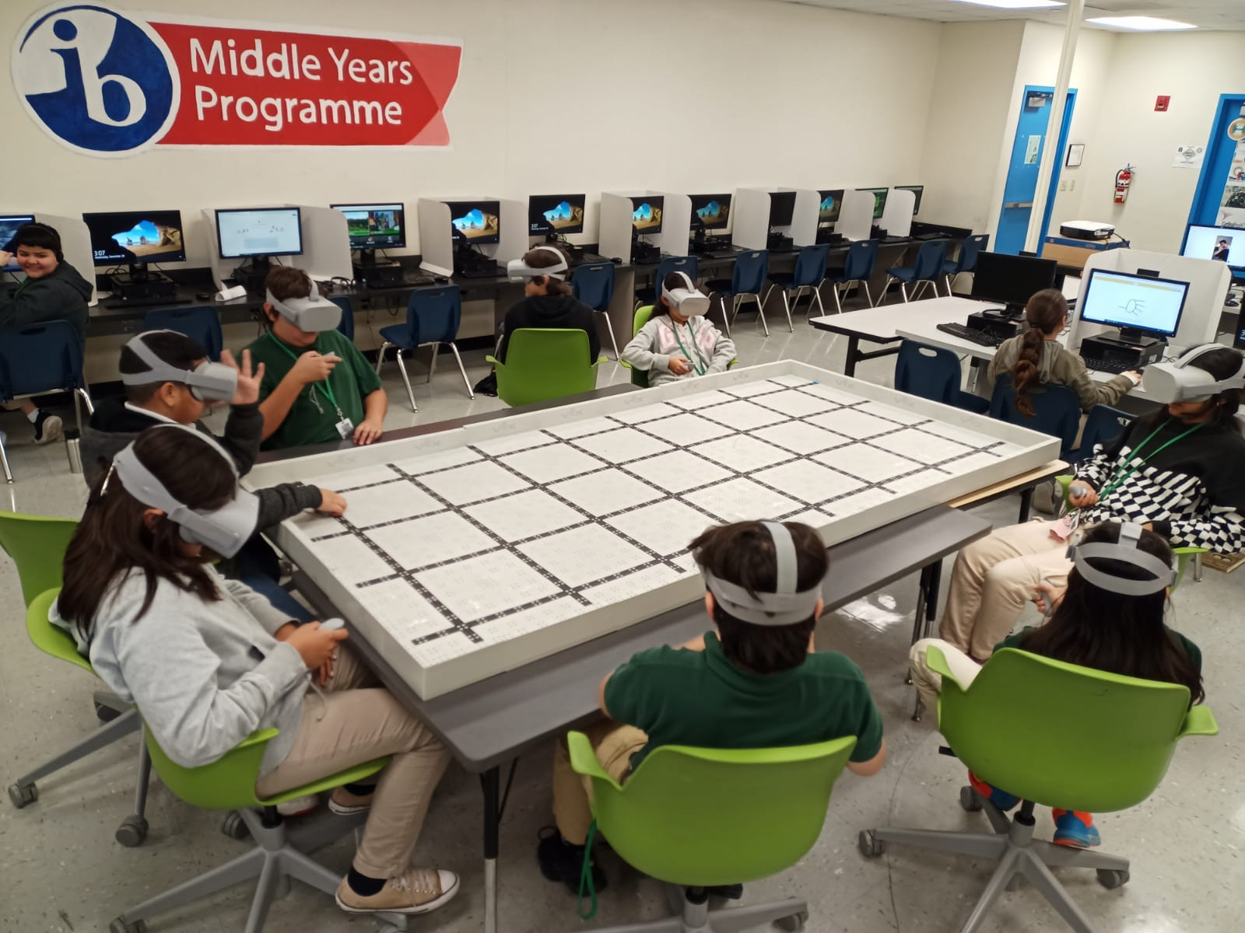
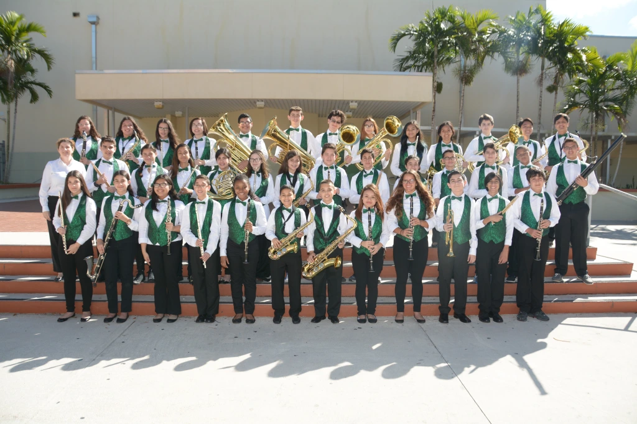
So many
Choices!

Slide 7



ELECTIVES FOR 6TH GRADE
Dance 1
Culinary Arts 1
TV/Broadcasting
Theatre
Physical Education
Foreign Language (Spanish or French)
Based on FAST Results: Reading
MUSIC:
Band​
Chorus​
Exploring Music​
Music Design (linked with Technology)​
ART:
Art History​
Dimensional Studio/Digital Art​
TECHNOLOGY:​
Intro to Computers​
Coding Fundamentals​

Slide 8









A MULTITUDE OF EXPERIENCES...
Class projects, community service, field trips, competitions, guest speakers, and educational partnerships have helped us enhance the relevance between school and the real world!

Slide 9
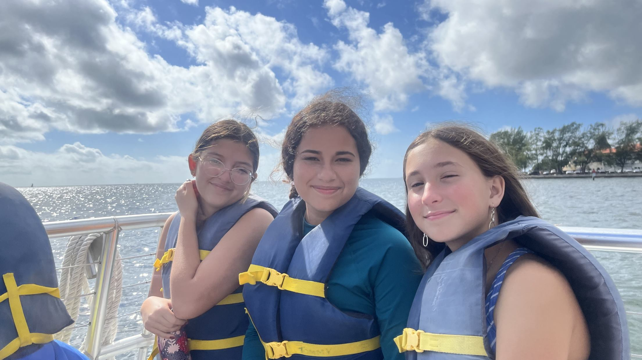

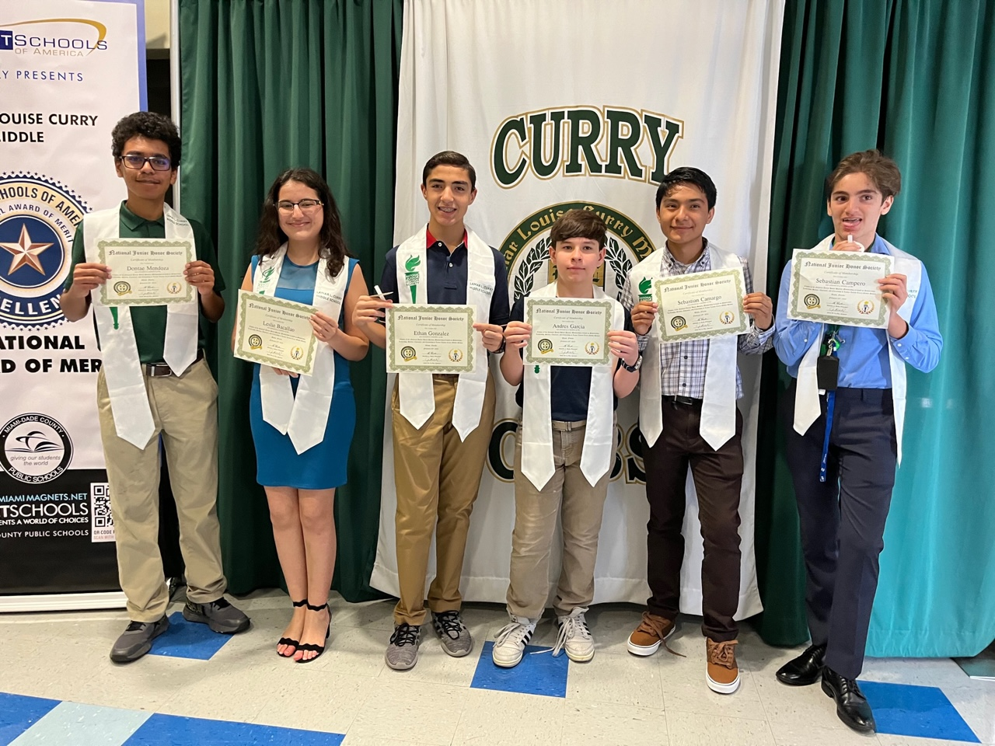
CURRY
CHOOSE

Slide 10
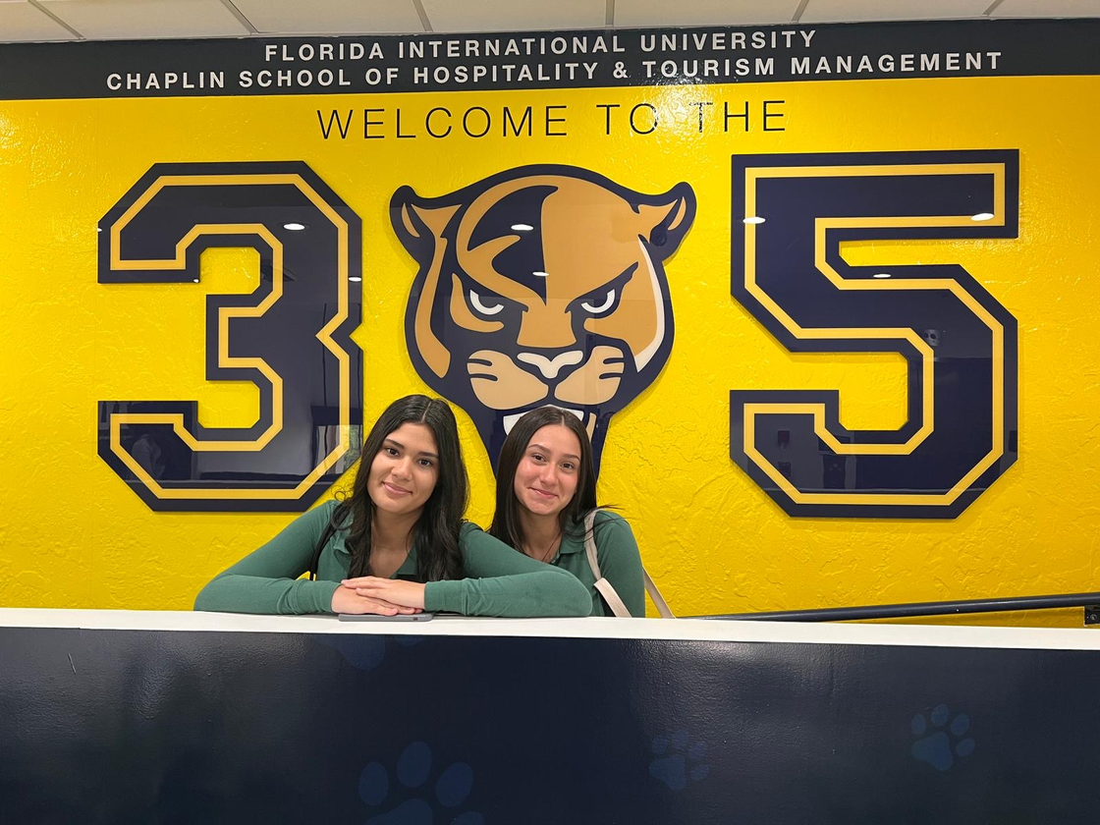
WHY CHOOSE CURRY???
Built in continuous support
  Free tutoring programs (before school, after school, virtual, and even Saturdays
  Academic Review/Data Chats
  Free Summer Transition programs
  Controlled and safe environment for our 6th graders (same floor)
A Top-notch Curriculum at a Nationally-Recognized School
  A multitude of elective choices and program flexibility
  A traditional middle school experience
  An international magnet program with continuum (Ferguson, Coral Reef, Coral Gables)
Tons of extra curricular opportunities!
  Clubs
  Sports
  Field Trips
  After School Care

Slide 11

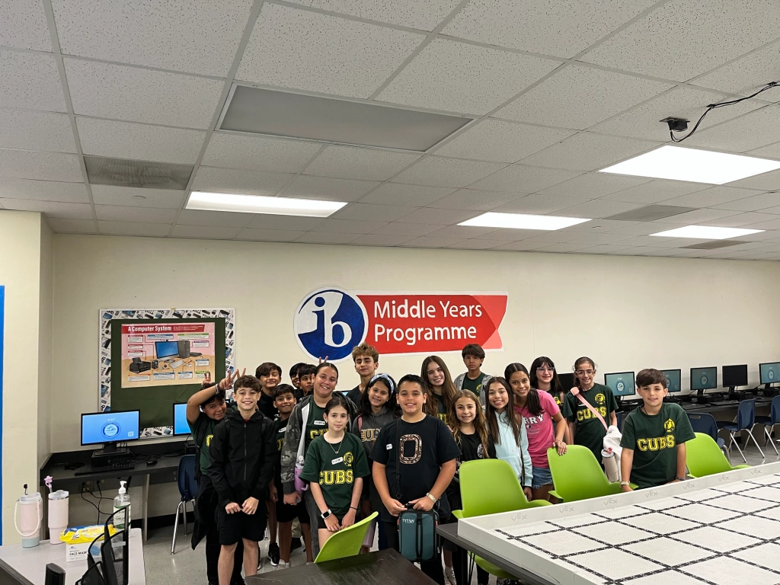
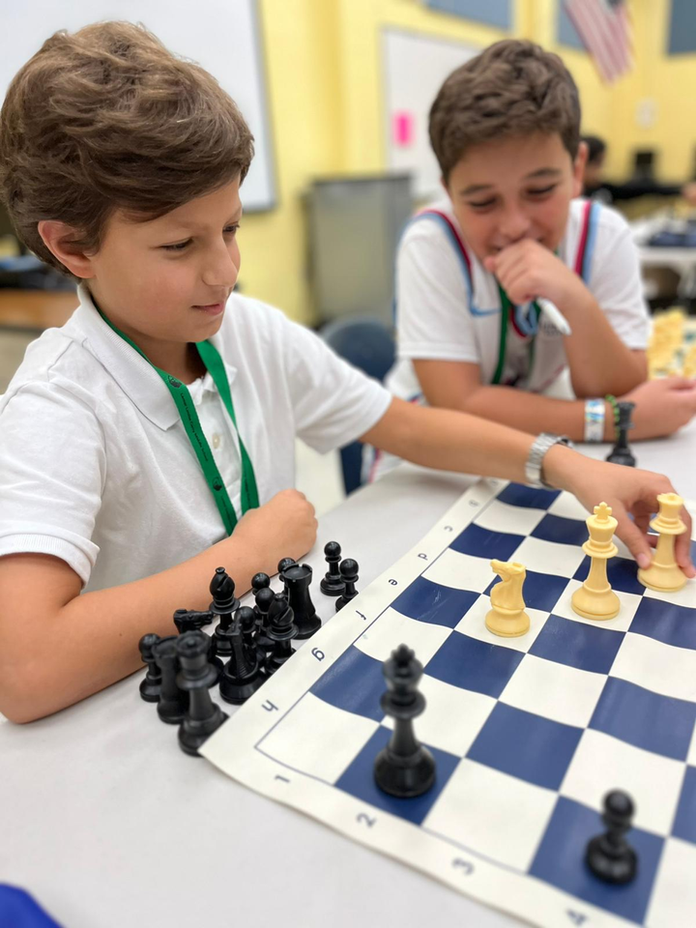

Extra Curricular
​CLUBS​ ​ | ​ACTIVITIES & SPORTS ​
ART CLUB ​ | BASKETBALL (BOYS)​
CHORUS AND BAND​ | BASKETBALL (GIRLS)​
FCCLA ​ | BOWLING (CO-ED)​
FIRST PRIORITY (Bible Club)​ | CROSS COUNTRY (BOYS)​
FISHING CLUB​ | CROSS COUNTRY (GIRLS)​
DRAMA ​ | SOCCER (BOYS)​
MATH CLUB ​ | TENNIS (CO-ED)​
NATIONAL HONOR SOCIETY ​ | TRACK (BOYS)​
NAT’L HONOR SOC. DANCE ARTS ​ | TRACK (GIRLS)​
PEER HELPERS/AMBASSADORS​ | VOLLEYBALL (BOYS)​
SECME/Robotics ​ | SOCCER (GIRLS)​
STUDENT COUNCIL ​ | SOFTBALL (BOYS)​
ENVIRONMENTAL/RECYCLING ​ | VOLLEYBALL (GIRLS)​​
YEARBOOK/JOURNALISM​ | FLAG FOOTBALL​
FBLA ​ | SOFTBALL (GIRLS)​
GEOGRAPHY CLUB​ | GOLF​
COMMUNITY SERVICE ​ | COMMUNITY SERVICE ​
A Powerful way to Learn outside of the classroom!

Slide 12

